Slide 1
PREDICTION OF LIVER CIRRHOSIS AND KIDNEY DISEASE
SDG GOAL :GOOD HEALTH AND WELL BEING (GOAL 3)
BATCH NO : A12
PROJECT GUIDE : Mrs P.Vijayalakshmi.M.Tech.,
TEAM MEMBERS : Indhumathi V (211420104101) Dheeksha J (211420104063)
Mohana priya S R (211420104164)

Slide 2
ABSTRACT
Liver Cirrhosis and kidney disease are both critical health conditions that can greatly benefit from the application of machine learning techniques for early detection and improved patient care. Cirrhosis is characterized by the gradual deterioration of liver function, while kidney disease can lead to impaired renal function. Leveraging supervised machine learning models on comprehensive clinical and laboratory datasets can help identify key biomarkers and patterns associated with these diseases. A dataset comprising clinical and laboratory features of patients with and without Cirrhosis and kidney disease is collected. By analyzing patient data, these models can assist healthcare professionals in diagnosing these conditions earlier and customizing treatment plans for better patient outcomes. The main objective is to predict whether a person has cirrhosis and kidney disease in the early stage . The accuracy of Gradient Boosting Algorithm and Random Forest Algorithm are 99 and 99.1 respectively.

Slide 3
Existing system
A dual-keyless-attention (DuKA) model that enables interpretable predictions of organ failure using electronic health record (EHR) data.
Three modalities of medical data from EHR, namely diagnosis, procedure, and medications, are selected to predict three types of vital organ failures: heart failure, respiratory failure, and kidney failure. DuKA utilizes pre-trained embeddings of medical codes and combines them using a modality-wise attention module and a medical concept wise attention module to enhance interpretation. Three organ failure tasks are addressed using two datasets to verify the effectiveness of DuKA.
DEMERITS
• Performance of BERT algorithm is poor .
• The accuracy range is from 80 to 90 percent
• They did not implement the deployment process.
• More complex process to train the data.

Slide 4
Literature Survey
TITLE | AUTHORS | METHODOLOGY | LIMITATIONS
The Diagnosis of Chronic Liver Disease using Machine Learning Techniques (March 2021) | Golmei Shaheamlung, Harshpreet Kaur | It combines three algorithm such as logistic regression,random forest and KNN to predict | Accuracy of the model is around 77 percent
Prediction and Analysis of Liver Disorder Diseases by using Data Mining Technique: Survey(2018) | Shambel Kefelegn, Pooja Kamat | Compares various data mining classification algorithm | Decision Tree is used for performance evaluation and it is not implemented
Liver disease prediction by using different decision tree techniques (2018) | Nazmun Nahar and Ferdous Ara | Calculates the performance of various decision tree techniques and compare their performance | Only decision tree algorithm is considered

Slide 5
TITLE | AUTHORS | METHODOLOGY | LIMITATIONS
A Comparative Study On Liver Disease Prediction Using Supervised Machine Learning Algorithms (November 2019) | A.K.M Sazzadur Rahman, F. M. Javed Mehedi Shamrat, Zarrin Tasnim, Joy Roy, Syed Akhter Hossain | Uses machine learning algorithm like SVM,KNN,Naïve Bayes and the performance of these techniques were estimated on various perspectives such as accuracy, precision, recall, f-1 score | Explored only few algorithms and it gives precision around 53%
Diagnosis of Liver Diseases using Machine Learning (February 2017) | Sumedh Sontakke, Jay Lohokare, Reshul Dani | Uses Back propagation and SVM algorithm | Accuracy of both algorithm is only 73%
Performance Evolution of Different Machine Learning Algorithms for Prediction of Liver Disease(December 2019) | Muktevi Srivenkatesh | Utilized a few learning calculation KNN, SVM, Logistic Regression, Navi Bayes, Random Forest to foresee patients with constant liver infection | Dataset comprises of only 580 datas

Slide 6
TITLE | AUTHORS | METHODOLOGY | LIMITATIONS
Prediction and Diagnosis of Liver Disease in Human Using Machine Learning | Adekola Olubukola Daniel ,Ekanem Edikan Uwem , Omidiran Daniel Tolulope | Utilizes large datasets collected by healthcare industries to automate the diagnosis of diseases | A supervised learning algorithm was used, and one has to manually retrain the model every time
Machine Learning Hybrid Model for the Prediction of Chronic Kidney Disease | Hira Khalid,Ajab Khan,Muhammad Zahid Khan,Gulzar Mehmood | Hybrid model consists of Gaussian Na¨ıve Bayes, gradient boosting, and decision tree | Predicts only liver disease

Slide 7
objective
The main aim is to implement an effective machine learning algorithm to predict and diagnose the occurrence of liver failure and kidney diseases in humans in order to eliminate the use of manual methods of analysis .
The objectives o include:
To obtain data on signs and symptoms of liver diseases in humans and to transform the stated factors into a suitable form for system coding.
To model a network that can predict the occurrence of liver disease based on the data set provided.
To implement an automated medical diagnosing system for early detection of liver failure and kidney disease using a single system at a time .
Significance
The output would mitigate late and incorrect prediction and diagnosis, which would save more lives.

Slide 8
PROPOSED SYSTEM
We proposed a system to develop the project using machine learning algorithm. Recently, Machine learning and Artificial intelligence has plays a big role in various industries for their improvement and development. So we tried to implement machine learning algorithm to diagnosis the Cirrhosis and kidney disease disease. We collected the previous record of patient who had the Cirrhosis and kidney disease disease and who does had the disease and those who had symptoms. By collection of those peoples information our machine is tried to identifies the pattern of the datasets by various performing calculations. After identifies the pattern using various machine learning algorithm the model can able to predict the instance based on previous information.The user can login using their credentials and they can add their data in our database and they can check whether they have chance of having liver cirrhosis and kidney disease by providing essential details .So that the user can predict liver cirrhosis and kidney disease in the early stage itself.

Slide 9
HARDWARE REQUIREMENTS SOFTWARE REQUIREMENTS
Processor : Pentium IV/III
Hard disk : minimum 80 GB
RAM : minimum 4 GB
FRONT END : HTML,CSS,DJANGO
BACK END : PYTHON
DATABASE : MYSQL 5.5
OPERATING SYSTEM : WINDOWS 7
IDE : ANACONDA WITH JUPYTER NOTEBOOK

Slide 10

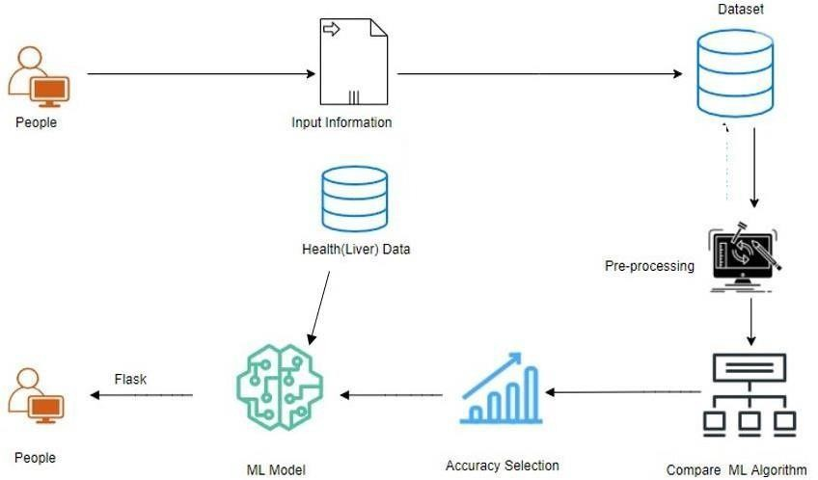
SYSTEM ARCHITECTURE
django

Slide 11
DATASET DESCRIPTION
This project uses 2 different dataset to predict liver cirrhosis and kidney disease respectively.
1)Cirrhosis Dataset
This dataset consists of 8786 records of patients combining those who had cirrhosis and those who are not having cirrhosis and the dataset attributes include age, gender, region, Weight, height, BMI, Obesity, Waist, Maximum and Minimum Blood pressure, Good Cholestrol, bad Cholestrol, Total Cholestrol , Dyslipidemia , PVD(Peripheral Vascular Disease), Physical Activity, Alcohol Consumption, Hypertension, Diabetes, Hepatitis , Chronic Fatigue, ALF(Acute Liver Failure).

Slide 12
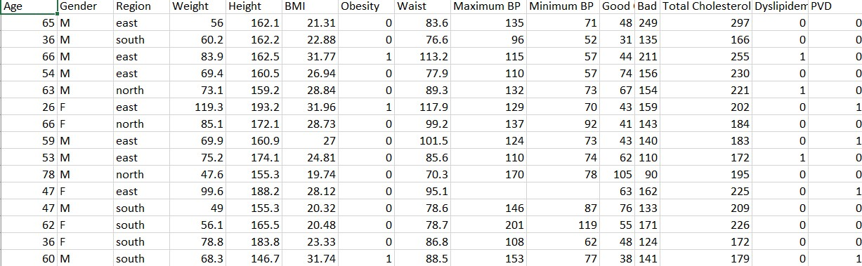
2) Kidney Disease Dataset
This dataset consists of 401 records of patients including those who had kidney disease and those who are not having and the dataset attributes includes BP(Blood Pressure), SG(Specific gravity), Al(Albumin level), Su(Salicycluric acid), Rbc(Hematuriadiasease), Bu(Blood urea nitrogen), Sc, Sod(Sodium), Pot(potassium), Hemo(haemoglobin), Wbcc(White blood cell count), Rbcc(Red blood cell count), Htn(Hypertensive Nephropathy), class(kidney disease).

Slide 13
Work flow diagram
Source Data
Data Processing and Cleaning
Training Dataset
Implementation of ML Algorithms
Best Model by Accuracy
Finding Liver Failure and kidney disease

Slide 14
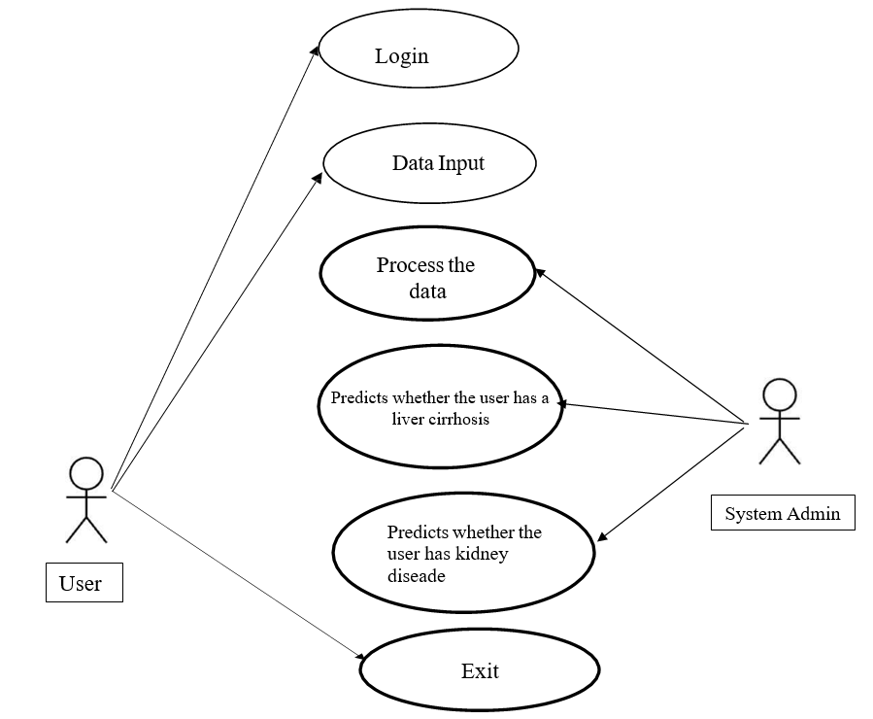
Use case diagram

Slide 15
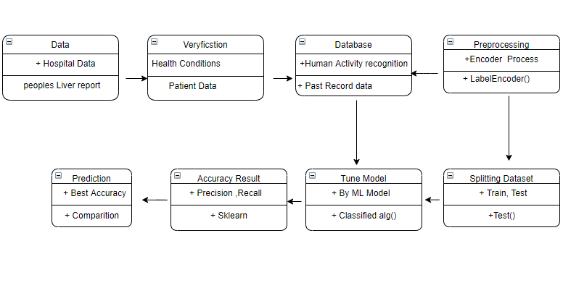
CLASS DIAGRAM

Slide 16
modules
1. Data Pre-processing
2. Data Analysis and Visualization
3. Implementation of Random Forest classifier algorithm
4 .Implementation of GRB algorithm
5. Deployment using Django

Slide 17
Data Pre-processing
Pre-processing refers to the transformations applied to our data before feeding it to the algorithm. Data Preprocessing is a technique that is used to convert the raw data into a clean data set. In other words, whenever the data is gathered from different sources it is collected in raw format which is not feasible for the analysis. Validation techniques in machine learning are used to get the error rate of the Machine Learning (ML) model, which can be considered as close to the true error rate of the dataset. During the process of data identification, it helps to understand data and its properties; this knowledge will help to choose which algorithm to use to build your model. Here are some typical reasons why data is missing:
• User forgot to fill in a field.
• Data was lost while transferring manually from a legacy database.
• There was a programming error.

Slide 18
DATA ANALYSIS and data VISUALIZATION
Data visualization is an important skill in applied statistics and machine learning.
Data visualization provides an important suite of tools for gaining a qualitative understanding.
This can be helpful when exploring and getting to know a dataset and can help with identifying patterns, corrupt data, outliers, and much more.
With a little domain knowledge, data visualizations can be used to express and demonstrate key relationships in plots and charts that are more visceral and stakeholders than measures of association or significance.
Understanding various types of plots, such as line, bar, histogram, and box plots, is essential for better understanding data.

Slide 19
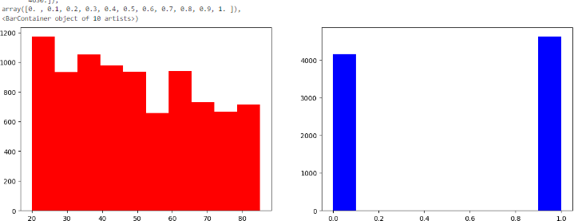
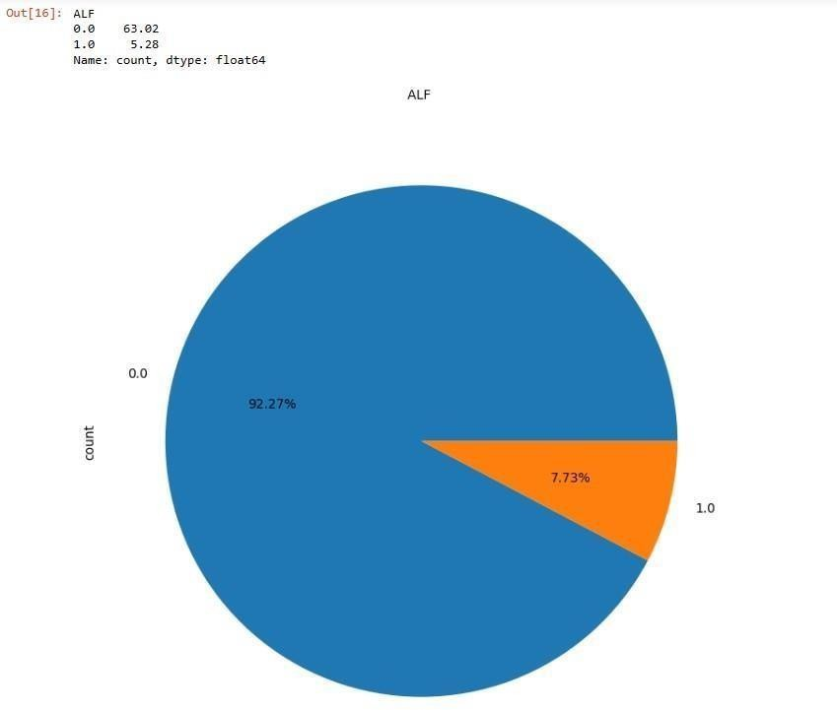
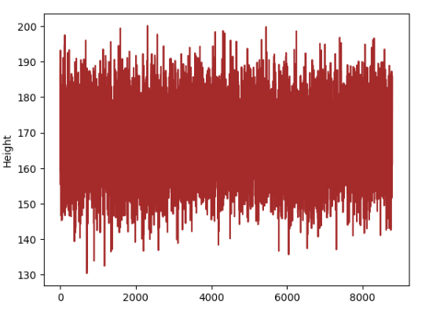
Bar Chart representation for age and gender
Pie-chart representation for ALF
Line plot representation for height

Slide 20
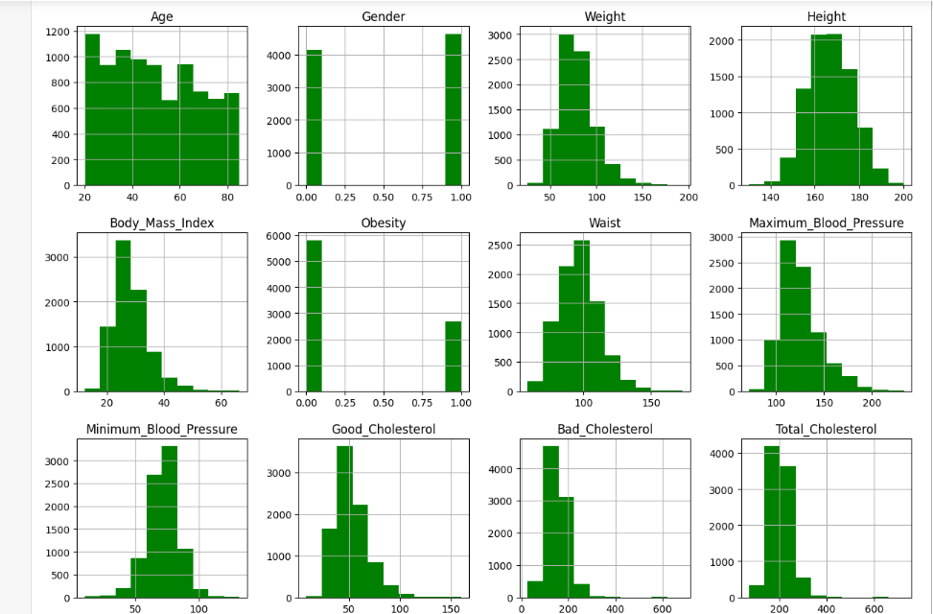
Histogram graph representation of the columns in the dataset

Slide 21
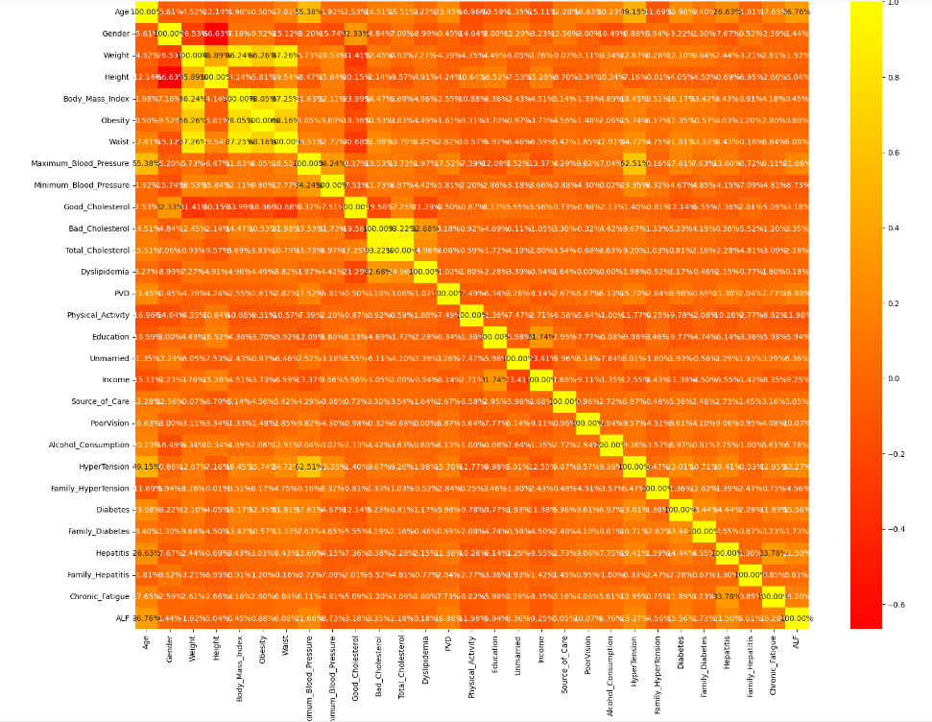
Heat Map Representation

Slide 22
RANDOM FOREST ALGORITHM
Random Forest is a popular machine learning algorithm that belongs to the supervised learning technique. It can be used for both Classification and Regression problems in ML. It is based on the concept of ensemble learning, which is a process of combining multiple classifiers to solve a complex problem and to improve the performance of the model.
As the name suggests, "Random Forest is a classifier that contains a number of decision trees on various subsets of the given dataset and takes the average to improve the predictive accuracy of that dataset." Instead of relying on one decision tree, the random forest takes the prediction from each tree and based on the majority votes of predictions, and it predicts the final output.
The greater number of trees in the forest leads to higher accuracy and prevents the problem of overfitting.Since the random forest combines multiple trees to predict the class of the dataset, it is possible that some decision trees may predict the correct output, while others may not. But together, all the trees predict the correct output.

Slide 23
[]
ADVANTAGES
It takes less training time as compared to other algorithms.
It predicts output with high accuracy, even for the large dataset it runs efficiently.
It can also maintain accuracy when a large proportion of data is missing.
THE CONFUSION MATRIX SCORE OF RANDOM FOREST CLASSIFIER:
[[ 994 20] [ 0 1013]]
THE CROSS VALIDATION TEST RESULT OF ACCURACY : [99.01332018 98.71731623 98.76604146 98.96347483 99.11154985]
THE ACCURACY SCORE OF RANDOM FOREST CLASSIFIER IS : 99.01332017760237
THE PRECISION SCORE OF RANDOM FOREST CLASSIFIER IS : 98.06389157792836

Slide 24
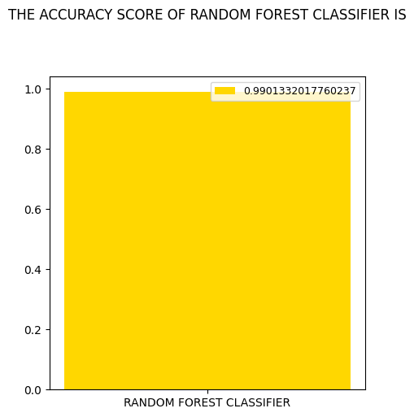
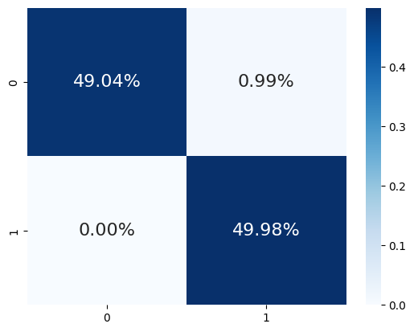
THE CONFUSION MATRIX SCORE OF RANDOM FOREST CLASSIFIER:
[[ 994 20] [ 0 1013]]

Slide 25
GRADIENT BOOST ALGORITHM
Machine learning is one of the most popular technologies to build predictive models for various complex regression and classification tasks. Gradient Boosting Machine (GBM) is considered one of the most powerful boosting algorithms.
Although, there are so many algorithms used in machine learning, boosting algorithms has become mainstream in the machine learning community across the world. Boosting technique follows the concept of ensemble learning, and hence it combines multiple simple models (weak learners or base estimators) to generate the final output.
This algorithm computes the gradient of the loss function with respect to the predictions of the current ensemble and then trains a new weak model to minimize this gradient. The predictions of the new model are then added to the ensemble, and the process is repeated until a stopping criterion is met.

Slide 26
Advantages
Good predictive performance.
Handles both numerical and categorical data.
Can capture complex relationships in the data.
Challenges
• May require tuning of hyperparameters.
• Prone to overfitting if hyperparameters are not properly set.
THE CONFUSION MATRIX SCORE OF GRADIENT BOOSTING CLASSIFIER: [[50 0] [ 1 49]]
THE CROSS VALIDATION TEST RESULT OF ACCURACY : [ 99. 100. 100. 99. 100.]
THE ACCURACY SCORE OF GRADIENT BOOSTING CLASSIFIER IS : 99.0
THE PRECISION SCORE OF GRADIENT BOOSTING CLASSIFIER IS : 100.0

Slide 27
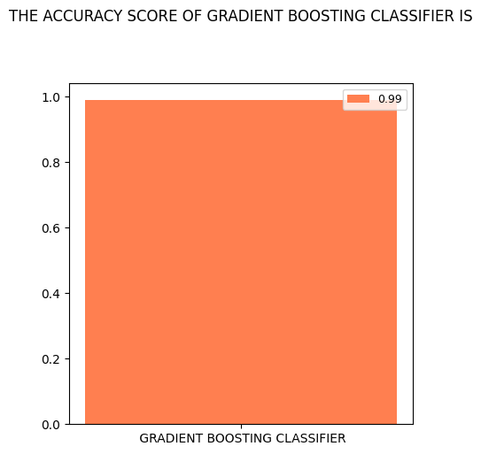
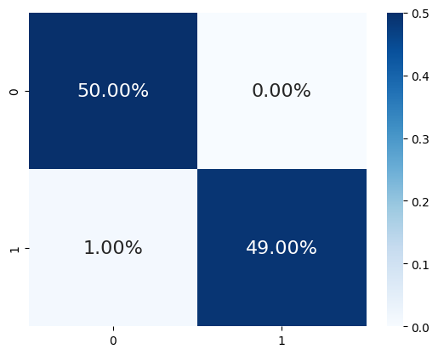
THE CONFUSION MATRIX SCORE OF GRADIENT BOOSTING CLASSIFIER:[[50 0] [ 1 49]]

Slide 28
DEPLOYMENT
In this module the trained deep learning model is converted into hierarchical dataformat file (.h5 file) which is then deployed in our Django framework for providing better user interface and predicting the output .The name of the package is used to resolve resources from inside the package or the folder the module is contained in depending on if the package parameter resolves to an actual python package or a standard module (just a .py file).
DJANGO
Django is a high-level Python web framework that encourages rapid development and clean, pragmatic design. Built by experienced developers, it takes care of much of the hassle of web development It’s free and open source. Django was designed to help developers take applications from concept to completion as quickly as possible. Django takes security seriously and helps developers avoid many common security mistakes. Some of the busiest sites on the web leverage Django’s ability to quickly and flexibly scale. With Django, you can take web applications from concept to launch in a matter of hours. It’s free and open source.

Slide 29
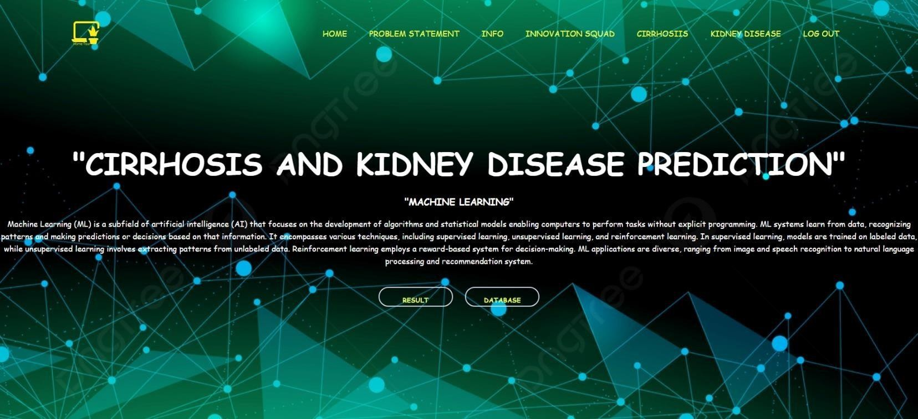
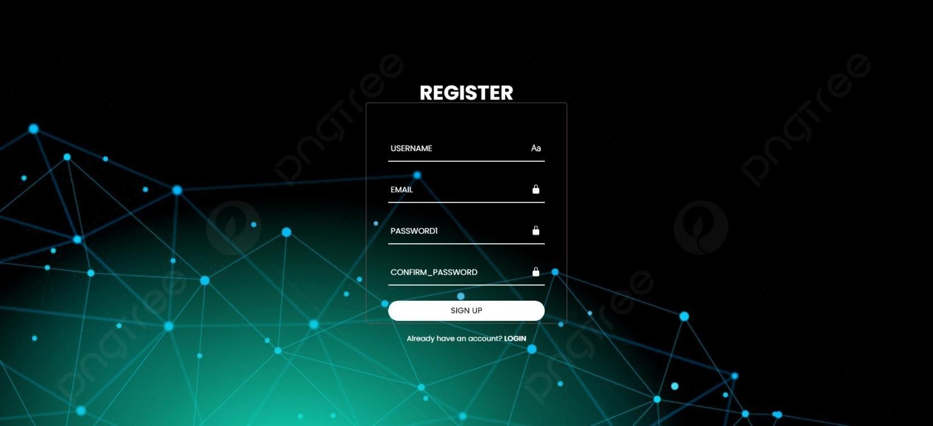
SCREENSHOTS
Home Page
Sign up and register page

Slide 30
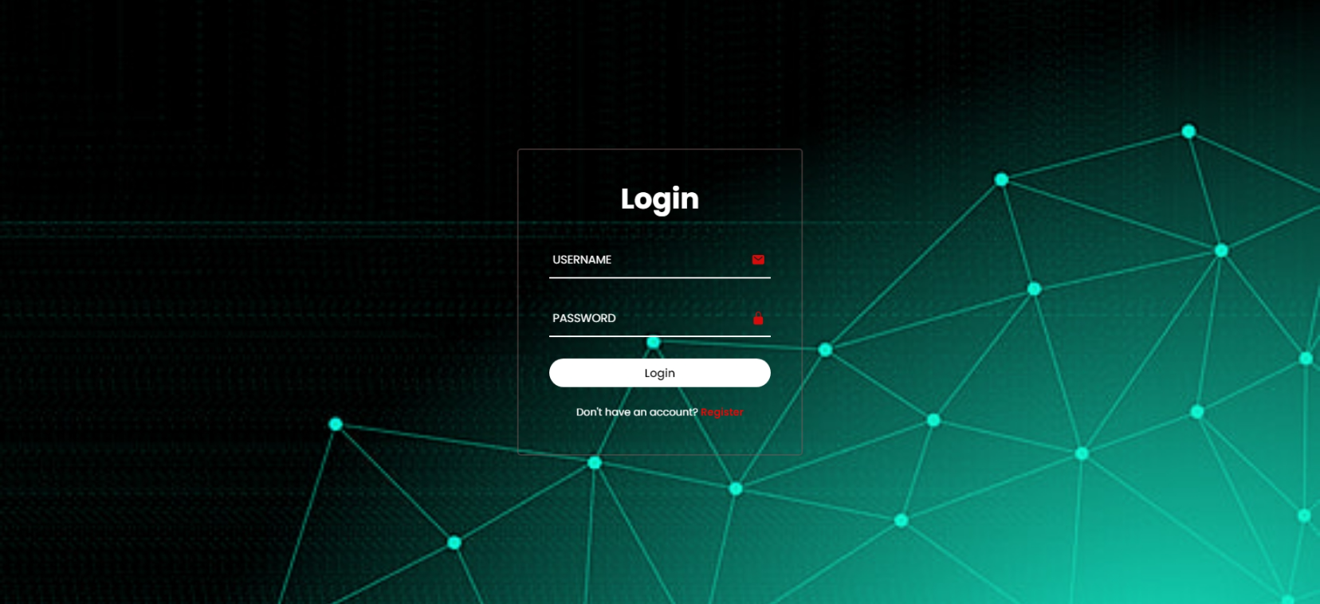
Login page

Slide 31
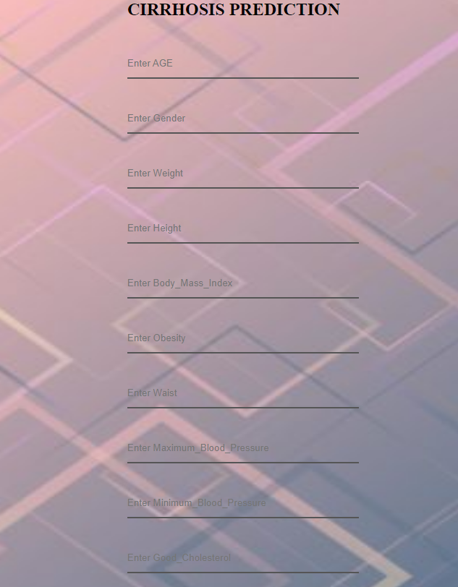
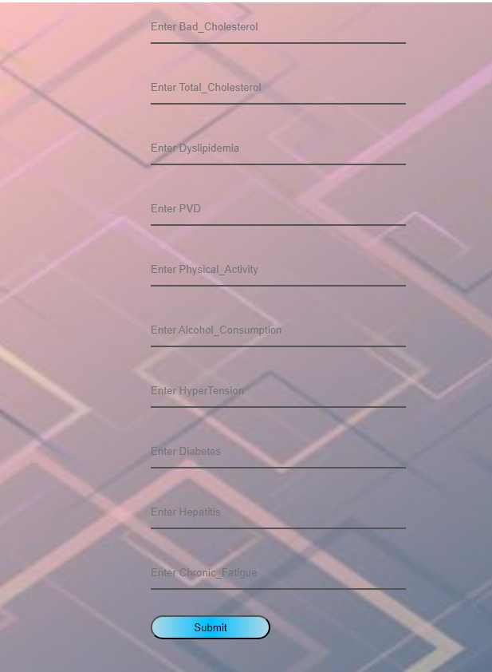
Liver Cirrhosis Prediction Page

Slide 32
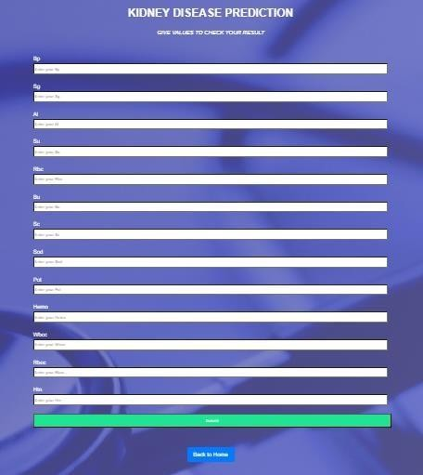
Kidney Disease Prediction Page

Slide 33
CONCLUSION
In conclusion, the application of advanced machine learning techniques, specifically Random Forest and Gradient Boosting, has proven to be instrumental in predicting the onset of liver cirrhosis and kidney disease. Through the analysis of relevant medical data, these models demonstrated a high level of accuracy and reliability in identifying key indicators and patterns associated with the progression of these conditions.
The subtle nature of liver disease's symptoms makes diagnosis especially difficult. Nearly 38,170 fatalities from chronic liver disease were reported in the United States in 2014 out of a total of 2,626,418 deaths. The significance of computer prediction will only increase. In order to increase prediction capacity, this project uses two potential machine learning algorithms. This project can help to find the Liver Failure stage based on the patient health.

Slide 34
Future work
Continued research and refinement of these models could pave the way for personalized and proactive healthcare strategies, ultimately contributing to better patient care and outcomes in the realm of hepatic and renal health.
Future works include automating this process by showing the prediction result in web application or desktop application.
We can deploy this model in any cloud based system.
Developing wearable devices and remote monitoring technologies for continuous assessment of liver and kidney function could revolutionize disease prediction and management. These devices could track relevant biomarkers, physiological parameters, and lifestyle factors, providing timely feedback and early warning signs of disease progression.
Integrating prediction models into clinical decision support systems (CDSS) can assist healthcare providers in risk stratification, treatment planning, and patient management.

Slide 35
BASE PAPER lINK
DuKA: A Dual-Keyless-Attention Model for Multi-Modality EHR Data Fusion and Organ Failure Prediction | IEEE Journals & Magazine | IEEE Xplore

Slide 36
THANK YOU.

